Slide 1
RH CaaS on BareMetal POC
16th May 2024
Demo 1 – Infra Testing
Please note this session will be recorded.

Slide 2
Agenda
RH CaaS on BareMetal Infra Testing
Overview of the lab environment – WWT ATC lab
RedHat logical setup
Zero Touch Provisioning and Automation - GitOps
Demo:
Bare Metal Inventory
Workflow integration with GitOps
Creation of 3-node cluster w/ ODF via GitOps
Demonstrate pre-deployed OpenShift Cluster,
Logging and monitoring capability
RBAC
Create new user credentials for a workload cluster
Change the size of a PVC
Scaling-up the 3-node cluster with an extra node
Initiate cluster upgrade via GitOps.
If time allows,
Scaling down cluster
Deleting a cluster
Next Steps..

Slide 3
Lab Environment Setup

Slide 4
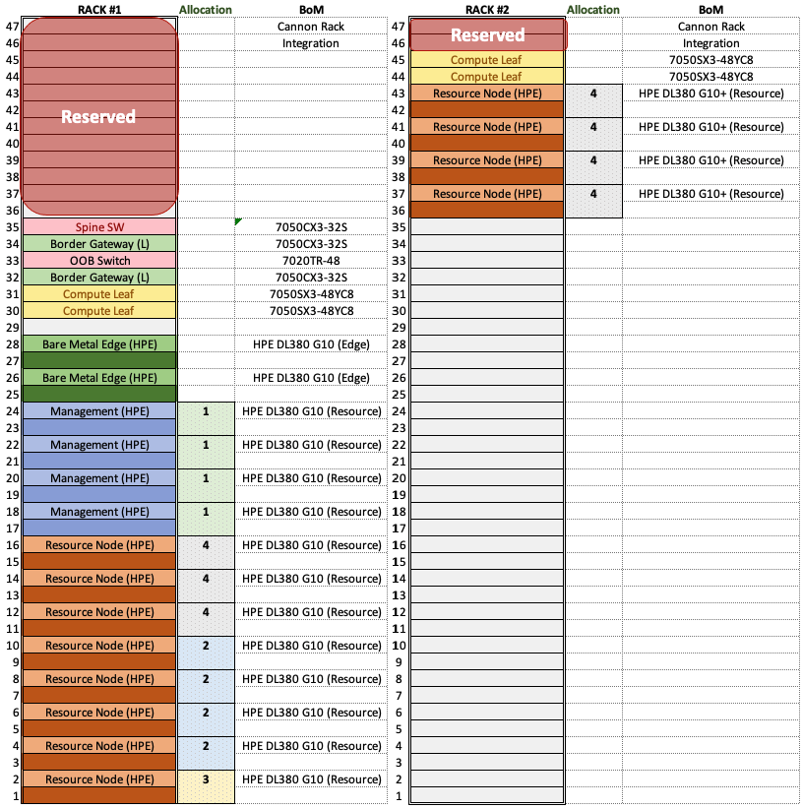
Physical Rack Layout
Rack 1: ATCDC2-B12
Spine switch
OOB switch
Border gateway switch x2
Compute leaf switch x2
Bare metal edge server x2
Allocation 1 - Management cluster
Gen10 x4
Allocation 2 – vSphere cluster
Gen10 x4
Allocation 3 – vSphere / Tanzu
Gen10 x1
Allocation 4 – OpenShift
Gen10 x3
Rack 2: ATCDC2-B06
Allocation 4 – OpenShift
Gen10+ x4
Notes:
What is the handover point? How to make resource cluster visible to RH ? – what do the servers have set up initially? How to expose the platform to RH, via iLO IP or other?

Slide 5
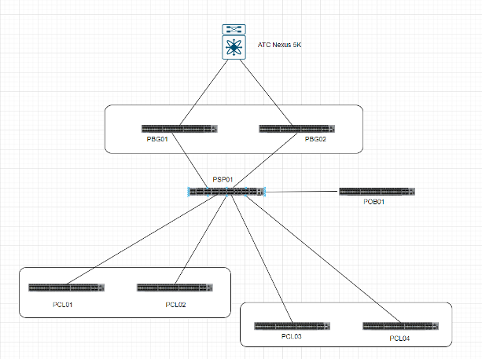
Networking Architecture
Example Networking​
VLAN: 883​
Subnet: 10.253.172.96/27​
Default Gateway: 10.253.172.97​
DHCP Scope IP Range: 10.253.172.107-10.253.172.126​
api.uk-vmo2-acm01.wwtpoc.local = 10.253.172.101 ​
*.apps.uk-vmo2-acm01.wwtpoc.local = 10.253.172.102
Similar networking for resource clusters
Notes:
What is the handover point? How to make resource cluster visible to RH ? – what do the servers have set up initially? How to expose the platform to RH, via iLO IP or other?
After Rack and Stack, How do WWT make IPs visible to RH or RH needs to discover the IPs? What do the sever set up(OS) initially?

Slide 6
Handover to Red Hat
Bare metal servers provided without any manual changes.
Servers used in existing vSphere clusters were gracefully removed from vSphere, but no changes made on the server itself.
Gen10+ servers had been racked, physically cabled and had their iLO configured, but otherwise untouched.
Routers and switches configured appropriately with agreed networking.
Information required by Red Hat (ref document)
Networking details
vSphere login details (for deployment of ACM)
iLO IP and login credentials

Slide 7



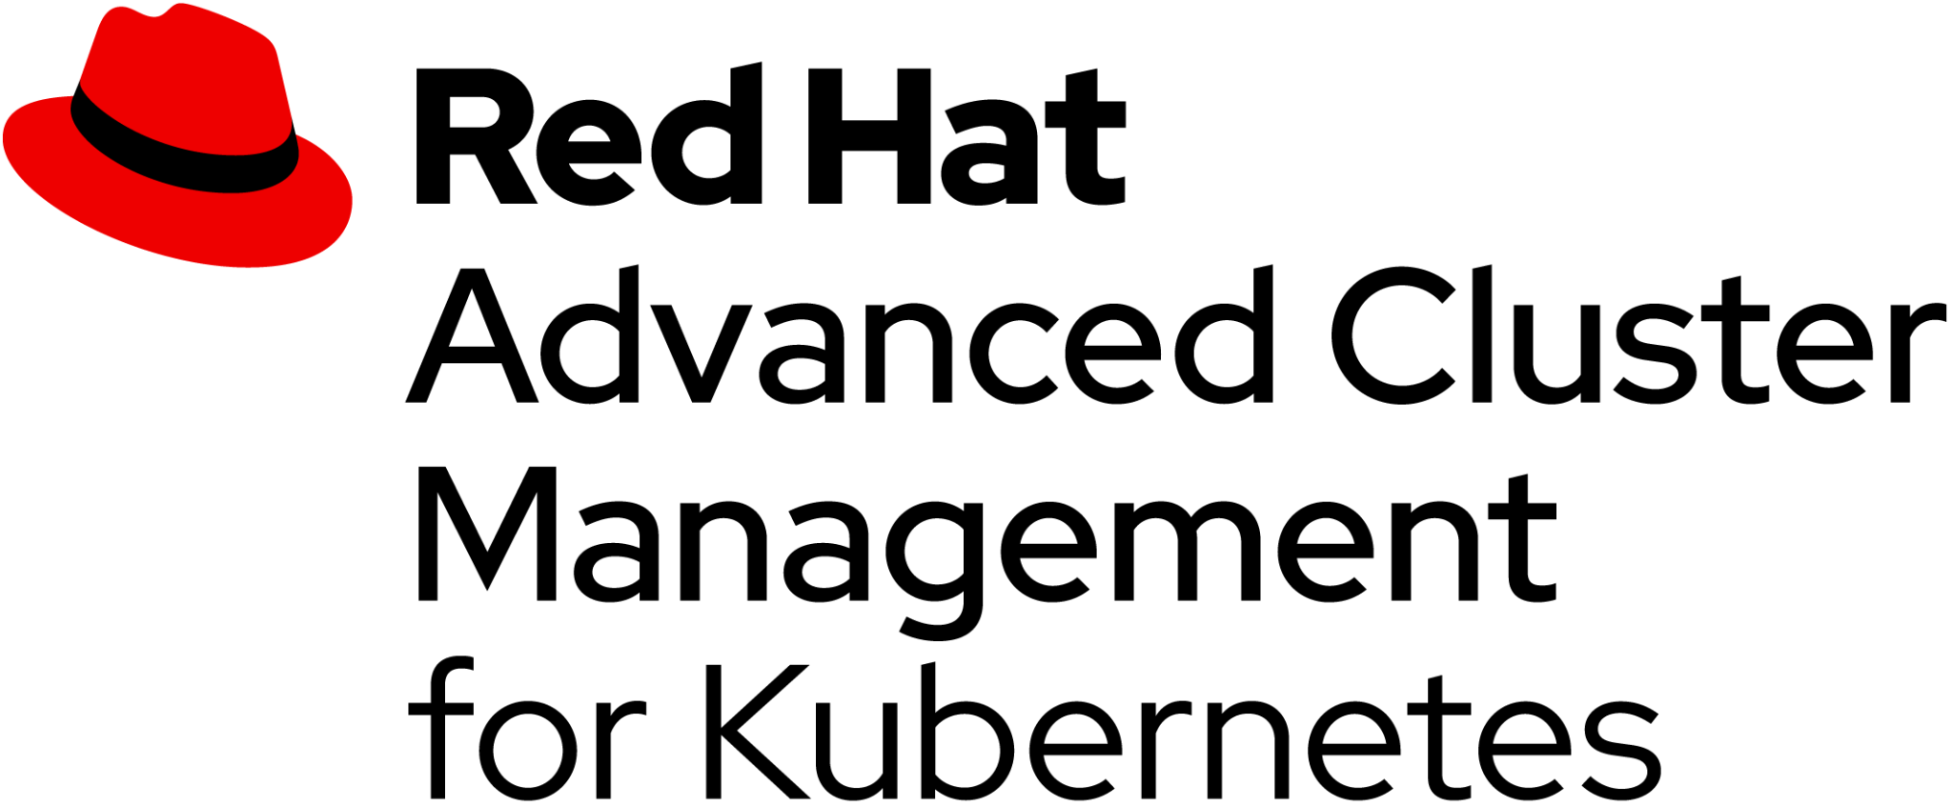
OpenShift Logical Setup
Management cluster
Workload cluster
CNF / VM workloads
OpenShift Control Plane x3
OpenShift Workers x N
OpenShift 3 +3 node cluster
Server
Server
Server
Server
Server
VM ctl
VM ctl
VM ctl
VM wn
VM wn
VM wn
Management software is hosted on a standard virtualized OpenShift Cluster deployed in the COE vSphere management cluster.
Workload clusters are deployed directly onto the bare-metal servers.

Slide 8
Zero Touch Provisioning and Automation
Bare Metal Inventory & GitOps

Slide 9
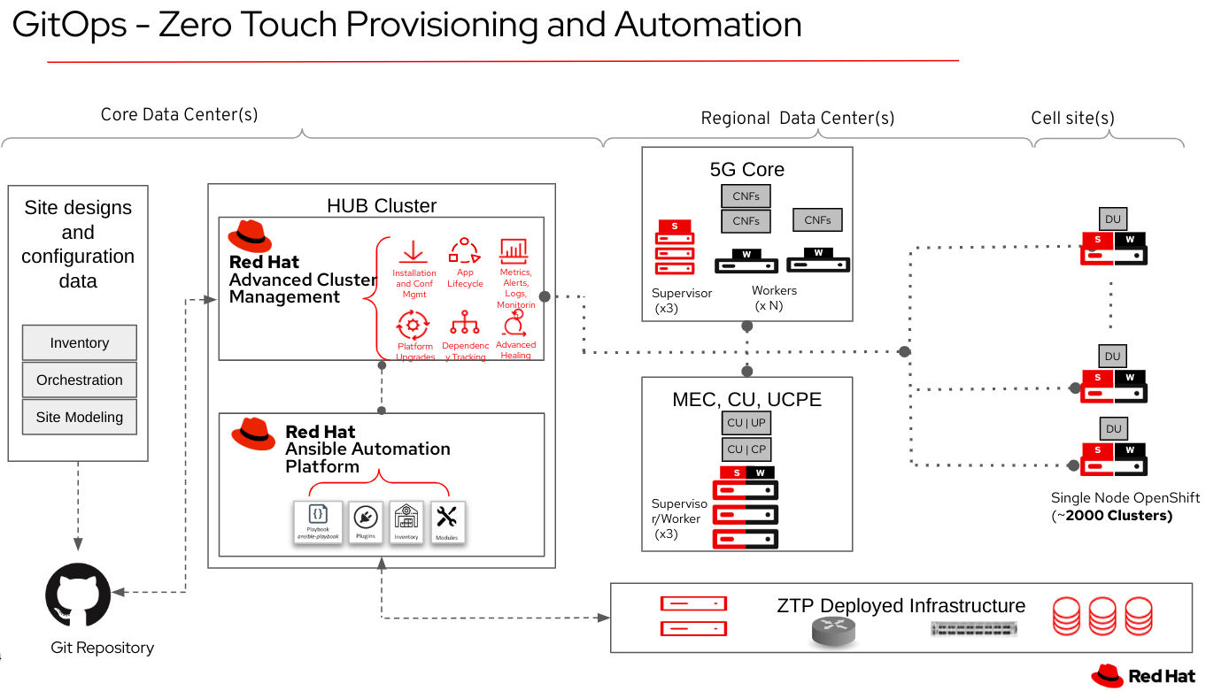

Slide 10
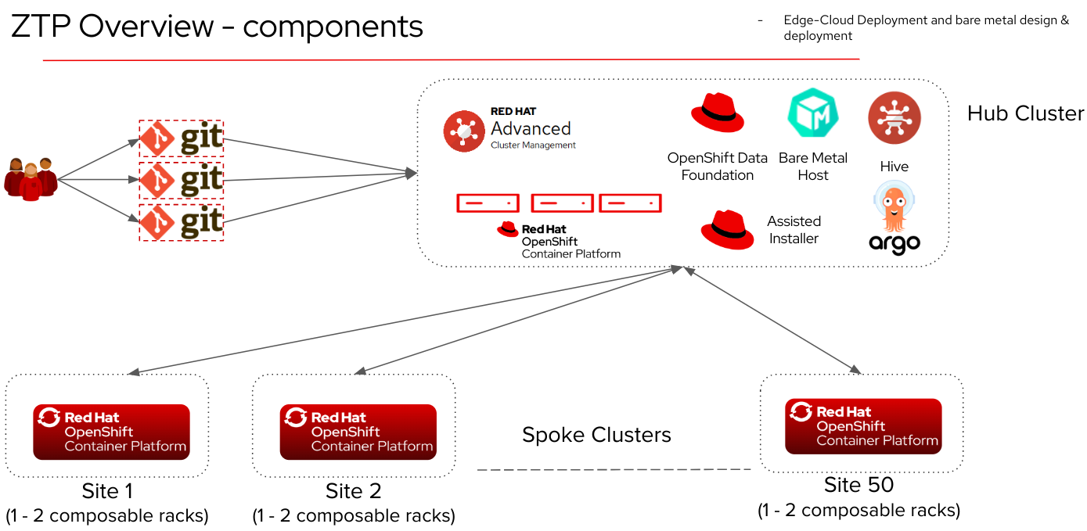

Slide 11
Demo..

Slide 12
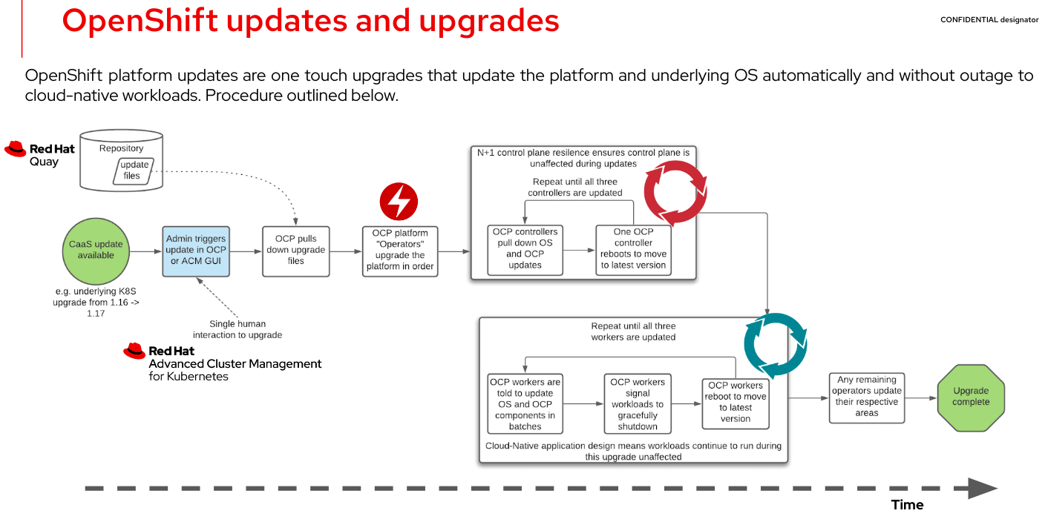

Slide 13
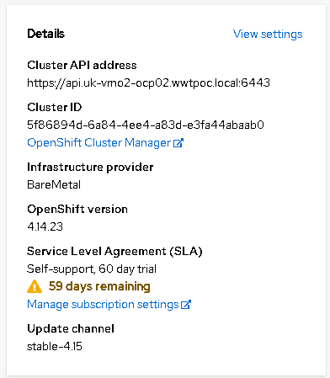
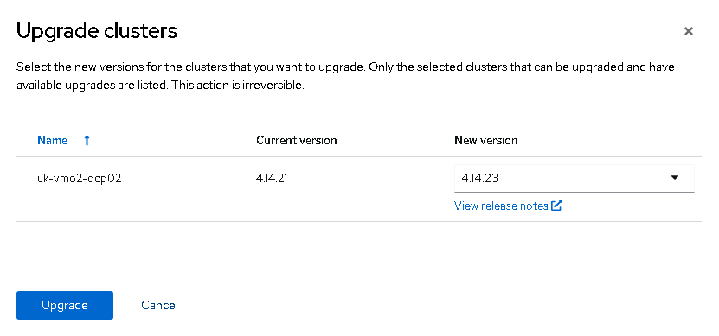
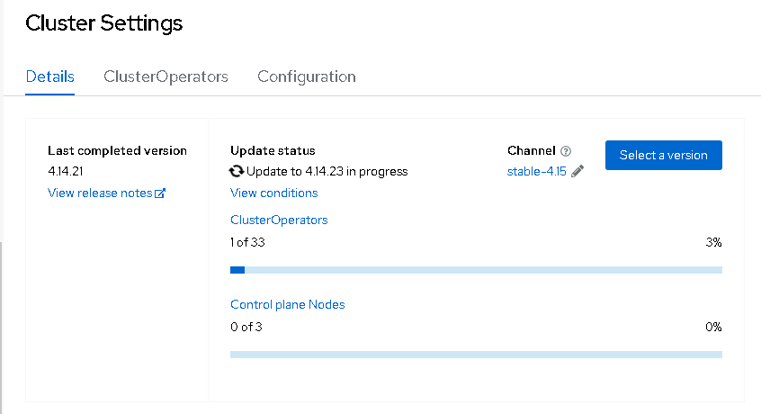
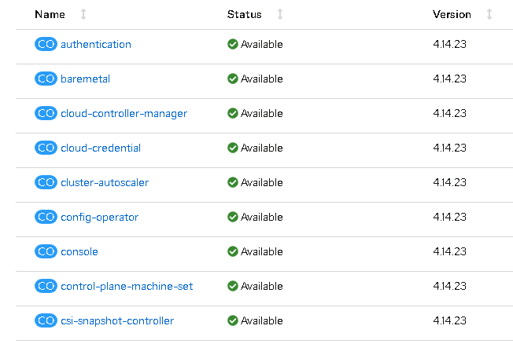
OpenShift Cluster Upgrade
Initiate Cluster Upgrade
Cluster Upgrade complete
Cluster Upgrade progress

Slide 14
Next Steps…
RH CaaS on BareMetal
Infra Testing
- SR-IOV performance throughput testing of OpenShift cluster
- Cluster customization e.g. SR-IOV
- Underlay orchestration (TBD by VMO2)
Application Testing - TBD
- Mav IMS CNF onboarding
- Mav IMS application specific use cases i.e. To be defined
- Application LCM ie. ISSU
- Application Workload migration
- Throughput & Performance testing
Notes:
Throughput testing: SR-IOV and DPDK performance throughput testing of OpenShift cluster

Slide 15
Thank you

Slide 16

High Level Reference Architecture
Management Cluster (site A)
Management Cluster (site B)
Cloud provisioning, management and monitoring components
OpenShift Cluster
Replication
OpenShift Cluster
Deployment and configuration management
Lifecycle management
Policy and Security
Platform and workload metrics
Workloads
Workload Clusters (Site 1)
Workload Clusters (Site 2)
Workload Clusters (Site N)
CNFs
CNFs
CNFs
VMs
VMs
VMs
Container
Container
Container
OpenShift Cluster
OpenShift Cluster
OpenShift Cluster

Slide 17
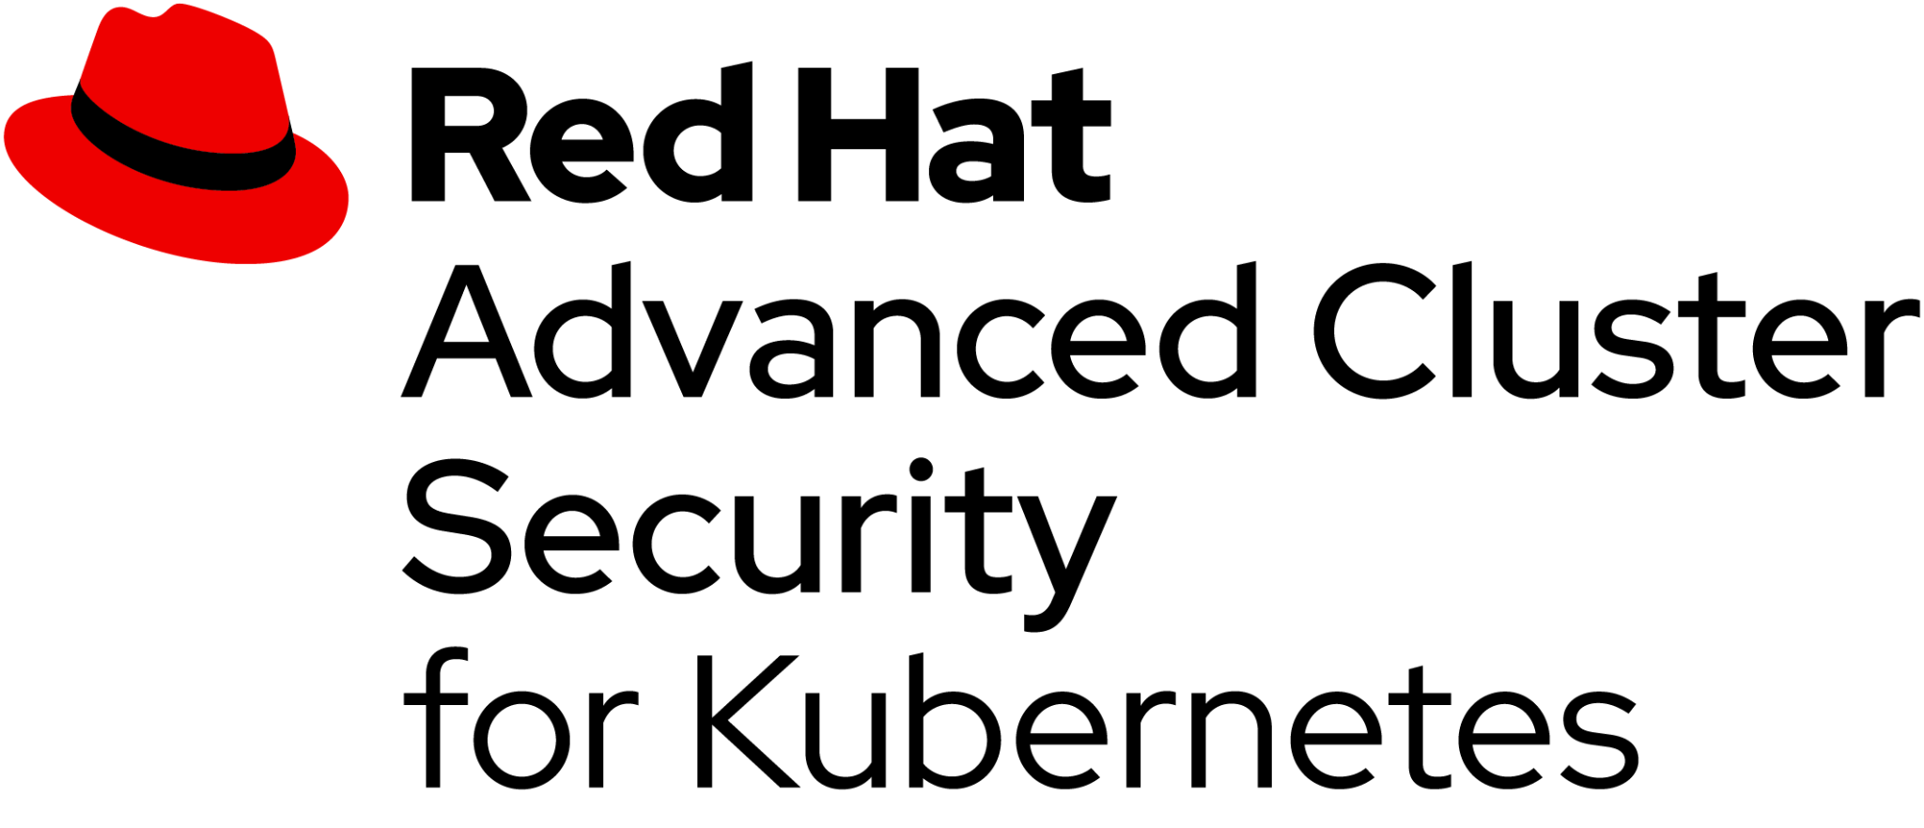

Telco Network Cloud Reference Architecture
Management Cluster
Workload Clusters
NSSF
AUSF
UDM
NEF
NRF
UPF
AMF
SMF
AF
PCF
Bare Metal
Bare Metal

Slide 18












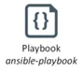








Zero Touch Provisioning and Automation with GitOps
Core Data Center
Regional Data Center(s)
POP(s)
Regional Cluster
Service Management and Orchestration
Management Cluster
Encoder
S
Origin
Cache
Red Hat
Advanced Cluster Management
S
W
W
W
Inventory
Installation and Conf Mgmt
App Lifecycle
Metrics, Alerts, Logs, Monitoring
Supervisor
(x3)
Workers
(x N)
Orchestration
Site Modeling
Platform Upgrades
Dependency Tracking
Advanced Healing
Cache
Helm
ZTP
Regional Cluster
S
W
Playbooks
Red Hat
Ansible Automation
Platform
Encoder
Cache
Origin
S
W
S
W
Single Node OpenShift (~2500 Clusters)
Supervisor/Worker
(x3)
Site Designs & Inventory
Git Repository
INFRASTRUCTURE
Notes:
Zero Touch Provisioning (ZTP) is a process that makes use of multiple Red Hat products and technologies to install and configure OpenShift and associated Operators onto a set of bare metal nodes. ZTP completes when OpenShift and the associated Operators are installed and configured.
Redhat Advanced Cluster Management (ACM)
GitOps
Ansible Automation

